Slide 1



Noida Institute of Engineering and Technology, Greater Noida
Indian Religion, Philosophy, and Practices
Unit: III
Subject Name:
Indian Traditions ,culture & Society
(KNC 602)
Dr.Ankita Shukla
Assistant professor
Department-MBA
Course Details
(B.Tech 6th Sem.)

Slide 2
Index/Content
S. No. | Index
1. | Content
2. | Unit Objective(s)
3. | Course Outcome(s)
4. | CO-PO Mapping
5. | Requisite & Recap
6. | Objectives of Topic/Session
7. | Topic Mapping with course outcomes
8. | Lecture

Slide 3
Index/Content
S. No. | Index
9. | Video Links
10. | Daily Quiz
11. | MCQs
12. | Assignment
13. | Old Question Papers/Expected Questions
14. | Summary
15. | References

Slide 4
Content
Introduction to Pre-Vedic and Vedic Religion:
Pre-Vedic and Vedic Religion
Buddhism and Jainism
Six System Indian Philosophy
Shankaracharya
Various Philosophical Doctrines
Other Heterodox Sects
Bhakti Movement, Sufi movement, Socio religious reform movement of 19th century and
Modern religious practices.

Slide 5
Unit Objective(s)
To enable the students to understand
Pre-Vedic and Vedic Religion
To sensitize students towards Bhakti Movement
To aware the students about modern religious practices.

Slide 6
Course Outcome
CO3. Ability to understand, Pre-Vedic and Vedic Religion.

Slide 7
CO-PO and PSO Mapping
Unit-III | So. No. | Mapping
 |  | CO | Level | PO | Level | PSO | Level
III | 1 | 2 | High | 1 | High | 1 | High
 | 2 | 3 | High

Slide 8
Topic Mapping with course outcomes
Unit-III | So. No. | Mapping
 |  | Topic | Course Outcomes | Level
III | 1 | Pre-Vedic and Vedic Religion | CO1 CO3 | Medium High
 | 2 | Bhakti Movement | CO1 CO3 | Low High
 | 3 | Modern religious practices. | CO1 CO3 | Low High

Slide 9
Topic objectives
Students will be able to know the following concepts:
Introduction to Pre-Vedic and Vedic Religion
Introduction to Buddhism
Introduction to Jainism
Shankaracharya

Slide 10
Pre-Vedic and Vedic Religion
The Vedic age itself is divided into the Early Vedic Period (c.1500 – 1200 BCE) and
Later Vedic Period (c.1100 – 500 BCE). The reason being that society underwent drastic changes from the time the first Vedas were written to the appearance of later Vedic scriptures.
differences between the Early Vedic Period and Later Vedic Period
S.No. | Pre-Vedic Period | Vedic Period
1. | The caste system was flexible and based on profession rather than birth | The caste system became more rigid in this period with birth being the main criteria

Slide 11
Pre-Vedic and Vedic Religion
2. | There was no concept of Shudra or untouchables | Shudras became a mainstay in the Later Vedic period. Their sole function was to serve those of the upper-castes
3. | Women were allowed a greater degree of freedom in this period. They were allowed to participate in the political process of the time to a certain extent | Women were restricted from their participation in society by being relegated to subordinate and docile roles
4. | Kingship was fluid as the kings were elected for a fixed period by the local assembly known as Samiti | As society became more urbanized in this period, the need for stable leadership was realized. Thus the absolute rule of the Kings became more and more prominent
5. | Early Vedic society was pastoralist and semi-nomadic in nature | Society became more settled in nature. It became centred around agriculture in general

Slide 12
Pre-Vedic and Vedic Religion
6. | In the Early Vedic Period, the barter system was more prevalent with little to no monetary value transaction being part of the exchange | Although the barter system was still in practice, it was largely replaced by the exchange of gold and silver coins known as Krishnala
7. | Rigveda. This text is cited as the earliest text from this period | Yajurveda. Samaveda Atharvaveda

Slide 13
Vedic Religion
Vedic religion, also called Vedism, the religion of the ancient Indo-European-speaking peoples who entered India about 1500 BCE from the region of present-day Iran. It takes its name from the collections of sacred texts known as the Vedas. Vedism is the oldest stratum of religious activity in India for which there exist written materials. It was one of the major traditions that shaped Hinduism.

Slide 14
Vedic Religion
The authors of the Vedic hymns were the Aryans. But who were the Aryans? In the 19th century, Aryans were considered a race. Now it is thought of as a linguistic group of people who spoke Indo-European language from which later emerged Sanskrit, Latin, and Greek etc. This is reflected from the words in these languages which are similar in sound and meaning. Thus the Sanskrit words matri and pitri are similar to the Latin mater and pater

Slide 15
Vedic Religion
The early Aryans worshipped phenomena of nature in the form of nature gods. These forces of nature were worshipped as male or female gods.
Indra was the Aryan superman, the god of strength, foremost in battle, always ready to smite dragons and demons and to destroy cities. He was the God of thunder, the rainmaker, and the victor over the forces which the Aryans could not vanquish.
Agni the God of fire, received many beautiful tributes; he dominated the domestic fireplace, and marriages were solemnized in the presence of fire, as they are to this day in Hindu rites. Fire was the purest of the five elements and was held in high esteem.
Surya (Sun), Savitri (a solar deity to whom the famous Gayatri mantra is dedicated).
Varuna was the god of water. He was the sustainer of plant and animal life. It was his responsibility to uphold the natural order.
Soma (god of intoxicating juice soma).
Yama, the god of death, had a prominent place.
Vayu (the god of winds).
Prithvi was the goddess of Earth. and Usha, the goddess of Dawn.
A characteristic feature of the Vedic religion is that male deities like Varuna, Surya and Agni were given prominence and goddesses like Prithvi and Usha occupied a subordinate position.

Slide 16
Vedic Religion
The main factor in the expansion of the Aryan culture during the later Vedic period was the beginning of the use of iron around 1000 BC. The Rigvedic people knew of a metal called ayas which was either copper or bronze. In the later Vedic literature ayas was qualified with shyama or krishna meaning black to denote iron.

Slide 17
Buddhism
It is famous as it is the place where Gautama Buddha is said to have attained Enlightenment (Pali: bodhi) under what became known as the Bodhi Tree. Since antiquity, Bodh Gaya has remained the object of pilgrimage and veneration both for Hindus and Buddhists.
Buddhism, religion and philosophy that developed from the teachings of the Buddha, a teacher who lived in northern India between the mid-6th and mid-4th centuries BCE (before the Common Era). Spreading from India to Central and Southeast Asia, China, Korea, and Japan, Buddhism has played a central role in the spiritual, cultural, and social life of Asia, and, beginning in the 20th century, it spread to the West.

Slide 18
Buddhism
Types of Buddhism
Today, many forms of Buddhism exist around the world. The three main types that represent specific geographical areas include:
Theravada Buddhism: Prevalent in Thailand, Sri Lanka, Cambodia, Laos and Burma
Mahayana Buddhism: Prevalent in China, Japan, Taiwan, Korea, Singapore and Vietnam
Tibetan Buddhism: Prevalent in Tibet, Nepal, Mongolia, Bhutan, and parts of Russia and northern India

Slide 19
Buddhism
Dharma
Buddha’s teachings are known as “dharma.” He taught that wisdom, kindness, patience, generosity and compassion were important virtues.
Specifically, all Buddhists live by five moral precepts, which prohibit:
Killing living things
Taking what is not given
Sexual misconduct
Lying
Using drugs or alcohol

Slide 20
Buddhism
Buddhist Holy Book
Buddhists revere many sacred texts and scriptures. Some of the most important are:
Tipitaka: These texts, known as the “three baskets,” are thought to be the earliest collection of Buddhist writings.
Sutras: There are more than 2,000 sutras, which are sacred teachings embraced mainly by Mahayana Buddhists.
The Book of the Dead: This Tibetan text describes the stages of death in detail.

Slide 21
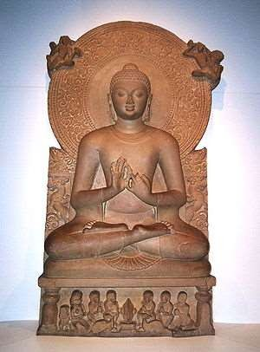
Origins
Buddhism
Around 530 BC a young prince named Siddhartha Gautama challenged the ideas of the Brahmin priests and created a new world religion .
Born in 563 BC into the warrior
caste
He lived in luxury in his family’s palaces and never experienced pain, suffering, or death
He married a beautiful woman
and they had a son.

Slide 22
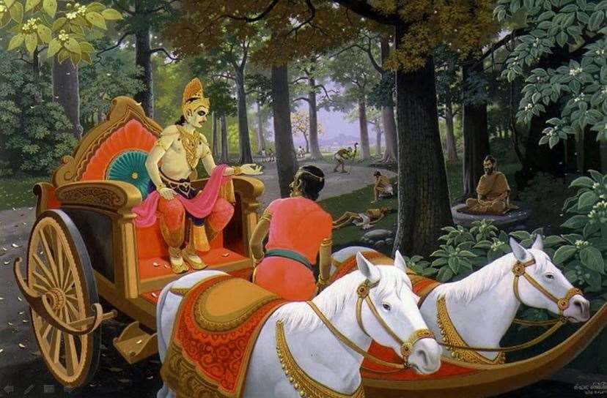
Buddhism
One day while riding in his chariot outside the palace walls, Gautama saw a sick man, an old man, and a dead man.
He realized that life was an endless cycle of pain and that the only way to escape that cycle was to seek wisdom
He left his family when he was about 29 and became a homeless wanderer with five other men who were also seeking wisdom.

Slide 23
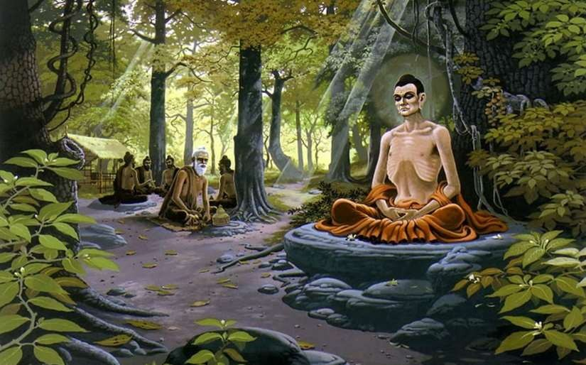
Gautama tried to find wisdom through physical suffering and
harsh discipline but instead he gained only pain.
At last, after days of meditating deeply in the shade of a tree, Gautama felt that the truth had come to him
At this point, he became to known as “The Enlightened One,” or
Buddha.
Buddhism

Slide 24
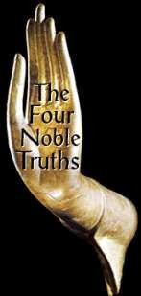
Four Noble Truths of Buddhism
First Noble Truth: Everything in life is suffering and sorrow.
Second Noble Truth: The cause of all this pain is people’s self-centered cravings and desires --- people seek pleasure that cannot last and that leads only to rebirth and more suffering.
Third Noble Truth: The way to end all pain is to end all desires.
Fourth Noble Truth: People can overcome their desires and attain enlightenment by following the Eightfold Path .

Slide 25

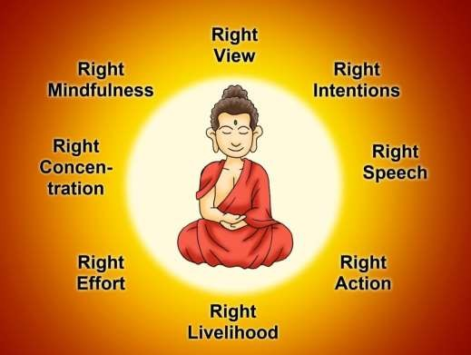
Noble Eightfold Path
Buddhism
He gave an Eightfold path. According to him the eightfold path is a way to end suffering.
Right view
Right intention
Right speech
Right action
Right livelihood
Right effort
Right mindfulness
Right meditation or concentration
By following the Eightfold Path, anyone could attain nirvana-- which was the release from all pain and suffering.

Slide 26
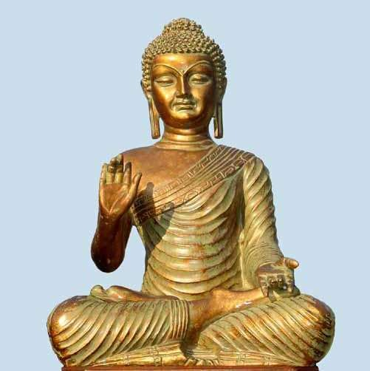
Buddhism
Buddha taught his followers to treat all living things (humans, animals, and even insects) with kindness and love.
Buddha eliminated the caste system, the rituals associated with Hinduism, and the ancient language (Sanskrit) of the Vedas and Upanishads.
Concerned with all human beings---women as well as men, and lowborn as well as highborn .

Slide 27
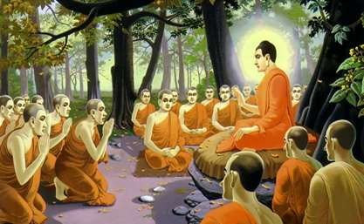
Refuge in the Three Jewels
Three things that Buddhists give themselves to, and in return look toward for guidance, in the process known as taking refuge.
Buddha – example of Buddha Or more loosely, the wisdom that
understands Dharma, and in this regard the Buddha represents the perfect wisdo that sees reality in its true form.
Dharma – teachings/laws as
expounded by Buddha
Sangha – community of those who
will help others attain bodhi
(enlightenment).
m

Slide 28
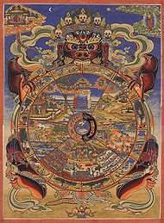
Buddhism
The most important symbol in Buddhism is the Wheel of Life which depicts the cycle of birth and life.
The eight spokes symbolize the Eightfold Path.
Buddhist teachings & beliefs were recorded in a
collection called the Tripitaka.

Slide 29


Pali Canon (Tipitaka):
Buddhism
Vinaya Pitaka: dealing with rules for monks and nuns
Sutta Pitaka: discourses, mostly ascribed to the Buddha, but some to disciples
Abhidhamma Pitaka: variously described as philosophy, psychology, metaphysics.
Pali Canon is the scripture collection
of the Theraveda Buddhist
tradition.
In Pali language-
Pitaka means basket
tipitaka means three basket.

Slide 30
Jainism
The word Jain is derived from Jina, which means the one victorious over the self and the external world. The Jinas are regarded more respect than the Gods. They include the 24 Tirthankaras or ford-finders (holy men), the last Tirthankara Mahavira (599-527 BC) is the founder of Jainism.

Slide 31
Beliefs in Jainism
In Jain thinking, a jiva is a soul, which is attached to a body.
The soul is of flexible size i.e. the same soul can fit inside a cat’s body as a human’s. The Jain scriptures state that there are 8.4 million species of jivas. The soul is also uncreated, eternal and has infinite power and knowledge and therefore has the inherent potential of divinity.
There are five levels of human development:
Sadhus (monks) and sadhvis (nuns)
Upadhyayas (teachers of the scriptures and philosophy)
Acharyas (leaders of the monastic community)

Slide 32
Beliefs in Jainism
Arihantas (liberated souls that have attained salvation; both Ordinary and Tirthankar and have achieved divinity. They can help others until death when they become siddhas)
Siddhas (liberated souls who reside in the highest level of heaven. They have no form and are detached from the earth)

Slide 33
Jainism
◻ Jainism is a way of life and one of the oldest religions
of the world.
◻ It believes in a cyclical nature of universe. It discourages superstition and blind faith and encourages free and rational thinking.
◻ Jainism lays heavy emphasis on non-violence (ahimsa)
and discipline.
◻ According to Jain philosophy, all Tirthankaras were born as human beings but they have attained a state of perfection or enlightenment through meditation and
self realization. They are the “Gods” of Jains.
◻ Jains have always practiced non-violence, vegetarianism, meditation, yoga, and environmentalism.

Slide 34










Principles of Jainism
Not to cause harm to any living beings by thoughts, speech or body
Non-violence towards all living creatures, in both thought
and action
Strengthens autonomy of thoughts & speech, and non-possessiveness
Non-violence (Ahimsa)
Multiplicity of Views (Anekäntväd)
Non-Possessiveness
/ Non-Attachment (Aparigraha)
A complete detachment from people, places, and material things
Truthfulness
(Satya)
To speak the harmless truth only
Non-Stealing (Asteya / Achaurya)
Not to take anything that is not properly given

Slide 35
Basic philosophies of Jainism
◻ Jainism believes in Godhood but does not believe God to be the First Cause. God is not a Creator, Preserver or Destroyer of the universe.
◻ “God” does not Punish or Reward
Each person is responsible for improving life by one’s self-endeavor
Each person is capable of achieving Godhood
◻ All Living Beings have Souls & are Equal
All life is sacred
Therefore, living in peace & harmony is essential
◻ Elimination of our Karmas is the Path to Liberation & Achievement of Godhood
It requires multiple re-births
◻ Ultimate Goal of Life
To be free from all karma

Slide 36
◻ The principles governing the successions of life cycles (birth, life, and death) is Karma.
Karma theory of Jainism
The Theory of Karma is founded on the simple law of cause and effect. What we experience now is the result of our own past action and our future is a function of our own choice and making.
Explains the role that karmas play in our lives, how we accumulate karmas, and how we get rid of them.
Actions of mind, speech, and body bind us with karma and our intentions and the passions determine the duration, strength and the results of the bondage.

Slide 37
Lord Mahavira
◻ Lord Mahavir - 24th (and final) Tirthankara
◻ Born on March 30, 599 B.C. (about 2600 years ago) as a prince in Bihar, India. He attained nirvana in the year 527 B.C. at the age of 72.
◻ The ultimate objective of his teaching is how one can attain the total freedom from the cycle of birth, life, and death, and achieve the permanent blissful state (known as liberation, nirvana, absolute freedom, or Moksha.)
◻ He shaped the present form of Jainism. Lord Mahavir envisioned men and women to be on equal footing in the matters of spiritual advancement.

Slide 38


Symbols in Jainism
Digit of moon – (region of liberated souls)
Three dots – (Right Perception/Faith, Right Knowledge, and Right Conduct)
Overall meaning – After removing all of their karmas, living beings will reside in the world of liberated souls.
Palm – signifies assurance; to have faith and change the path of righteousness.
Wheel of Dharma – 24 spokes represent the 24 Tirthankaras. The word inside the wheel is ahimsa.

Slide 39
Major Jain Religious events
◻ Mahavir Jayanti – celebration of the birth of Lord Mahavir
◻ Paryushan Parva – festival of forgiveness
◻ Samvatsari Pratikraman – 3 hour prayer to ask for forgiveness
◻ Mahavir Nirvan – celebration at Diwali/New Year’s per the lunar calendar

Slide 40






All souls are equal
Jain Beliefs
Non-Violence
Multiplicity of views Non-possessiveness Karma
Three jewels: Right Knowledge, Right Faith, Right Conduct

Slide 41
Six System Indian Philosophy
Hindu philosophy encompasses the philosophies, world views and teachings of Hinduism that emerged in Ancient India. These include six systems (shad-darśana) – Sankhya, Yoga, Nyaya, Vaisheshika, Mimamsa and Vedanta.
In Indian tradition, the word used for philosophy is Darshana. This word comes from the Sanskrit root drish (to see, to experience)

Slide 42
Six System Indian Philosophy
Nyaya
The founder of Nyaya is Akshapada Gautama and it dated back to 2nd Century BCE. It is a school that deals with logic and epistemology. Its main objective is to help to eliminate ignorance of knowledge. It enlists four valid (Pramana) and four invalid means of gaining knowledge. It is very closely linked with Vaisheshika School.

Slide 43
Six System Indian Philosophy
Vaisheshika
The Vaisheshika System of Indian Philosophy was founded by Kanada or uluka. Popularly understood as the atomistic school of Indian Philosophy. It elaborates on seven elements of matter with the nomenclature of Saptapadartha- Dravya (substance and also includes the Panchamahabhutas), Guna (Qualities), Karma (activities), Samanya (generalist traits), Vishesha (specialty), Samavaya (inter-relatedness) and the last addition which is Abhaava i.e absence

Slide 44
Six System Indian Philosophy
Samkhya
Sage Kapila founded the Samkhya System of Philosophy. Samkhya is an extremely complex school of philosophy that goes deep into the understanding of the creator and the creation. There are terms like Mahat, Purusha, Prakriti, Tri-Gunas, that are explored in this school. The school is credited to Sage Kapila.
The Mahat is the universal cosmic spirit. Purusha is the passive element whereas Prakriti is the active element which creates Manas(Mind) and the three Gunas- Sattva(Calm and composed), Rajas (momentum, dynamism and egoistic) and Tamas (imbalanced, chaotic and destructive).

Slide 45
Six System Indian Philosophy
Yoga
The Yoga Syatem of Philosophy was founded by Patanjali. While Samkhya highlights the three Gunas of Sattva, Rajas, and Tamas, the eight-limbs of Yoga Sutras of Patanjali highlight how to connect with the greater cosmic essence and enhance spirituality. These eight-limbs include- Yama (moral conduct), Niyama (Disciple), Asana (right posture), Pranayama (effective breathing), Pratyahara (withdrawing the senses), Dharana (to concentrate on one object), Dhyana (meditation), Samadhi (supreme bliss/ salvation).

Slide 46
Six System Indian Philosophy
Purva Mimamsa
Sage Jaimini is associated with Purva Mimamsa who is considered to be the disciple of Sage Vyasa. This text provides details on why is it important to conduct Vedic rituals for a person to attain the last ultimate goal of life which is Moksha (usually understood as Salvation). This deals with Karma Khanda i.e action based compendium of knowledge in the Vedas.

Slide 47
Six System Indian Philosophy
Uttara Mimamsa
Vedanta, as the name suggests, is the last of the four forms of Vedas, the other three being Brahmanas, Samhitas, and Aranyakas. Aranyakas and Vedanta form the Jnana Khada viz. a more metaphysical element for a person to explore. The beginning of Vedanta is credited to Sage Bhadrayana.
Vedanta was analyzed and interpreted by many thinkers that deserve a definite mention -- Advaita Vedanta by Shankaracharya, Vivishta Advaita by Ramanujacharya, Dvaita Vedanta by Madhavacharya, Dvaitadvaita Vedanta by Nimbaraka and Shuddha Advaita Vedanta by Vallabhacharya.

Slide 48
Shankaracharya
Shankaracharya (शङ्कराचार्य) (IAST: Śaṅkarācārya, Shankara acharya) is a commonly used title of heads of monasteries called mathas in the Advaita Vedanta tradition of Hindu Dharma.
The title derives from Adi Shankara, teachers from the successive line of teachers dating back to him are known as Shankaracharyas.
Adi Shankara set up four monasteries known as Mathas or Peethams, in the North, South, East and West of India, to be held by realised men who would be known as Shankaracharyas. They would take on the role of teacher and could be consulted by anyone with sincere queries of a spiritual nature

Slide 49
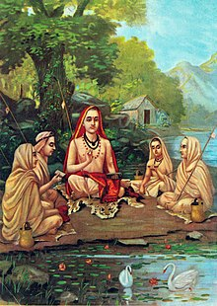
Shankaracharya
Adi Shankaracharya with his four disciples - Padmapadacharya, Sureshwaracharya, Hastamalakacharya & Totakacharya

Slide 50
Shankaracharya
4 Major Mathas in 4 Regions of India
Matha is a Sanskrit word and also refers to a monastery in Buddhism and Jainism. The matha tradition of Hinduism involved in education,support studies,culture and also the place where many new texts were composed. Adi Shankara has established four major mathas in different regions of India and list is as follows.
Govardhana Matha, Odisha – Rig Veda
Govardhana matha is located in the coastal city of Puri in Odisha and associated with the Lord Jagannath temple. The Eastern part of the Indian subcontinent from Bihar to till Rajamundry and Orissa to Arunachal Pradesh,comes under this Math.

Slide 51
Shankaracharya
Sharada Peetham, Karnataka – Yajur Veda:
Sringeri Sharada Peetha was established by Adi Shankara on the banks of the Tunga River in Chikkamagalur district in Karnataka. Town of Sringeri is the site of the first Matha in India and one of the famous matha in Karnataka state along with Ramachandrapura Math.
Dwaraka Pitha, Gujarat – Sama Veda
Dwaraka Matha is also called as Saradha Matha is situated in the ancient coastal city of Dwaraka in Gujarat. It is one of the four cardinal mathas established by Adi Shankara and associated with Dwarakadheesh Temple.

Slide 52
Shankaracharya
Jyotir Math, Uttarakhand – Atharva Veda
Jyotir Math or Jyotir Pitha is located in a city with same name Jyotirmath in Chamoli district of Uttarakhand. Jyotirmath is gateway to Himalayan mountains,trekking and pilgrim centres like Badrinath and Auli Ropeway, one of the longest ropeway in India.

Slide 53
Shankaracharya
Shishya (lineage) | Direction | Maṭha | Mahāvākya | Veda | Sampradaya
Padmapāda | East | Puri Govardhanmaṭha Pīṭhaṃ | Prajñānam brahma (Consciousness is supreme being) | Rig Veda | Bhogavala
Sureśvara | South | Sringeri Śārada Pīṭhaṃ | Aham brahmāsmi (I am the supreme being) | Yajur Veda | Bhūrivala
Hastāmalakācārya | West | Dvāraka Kalika Pīṭhaṃ | Tattvamasi (That thou art) | Sama Veda | Kitavala
Toṭakācārya | North | Badari Jyotirmaṭha Pīṭhaṃ | Ayamātmānam brahma (This Atman is supreme being) | Atharva Veda | Nandavala

Slide 54
Summary
We have covered the following topics in this lecture:
Introduction to Pre-Vedic and Vedic Religion
Introduction to Buddhism
Introduction to Jainism
Shankaracharya

Slide 55
Prerequisite and Recap
Introduction to Pre-Vedic and Vedic Religion
Introduction to Buddhism
Introduction to Jainism
Shankaracharya

Slide 56
Topic Mapping with course outcomes
Unit-III | So. No. | Mapping
 |  | Topic | Course Outcomes | Level
III | 1 | Various Philosophical Doctrines | CO1 | High High
 | 2 | Other Heterodox Sects | CO1 CO3 | High Low
 | 3 | Bhakti Movement | CO3 | High

Slide 57
Objectives of topic/Session
Students will be able to know the following concepts:
Various Philosophical Doctrine
Bhakti Movement
Bhakti Movement

Slide 58
Various Philosophical Doctrines
Indian philosophy refers to philosophical traditions of the Indian subcontinent. A traditional classification divides āstika(orthodox) and nāstika (heterodox) schools of philosophy, depending on one of three alternate criteria: whether it believes the Vedas as a valid source of knowledge; whether the school believes in the premises of Brahman and Atman; and whether the school believes in afterlife and Devas.
There are six major schools of orthodox (vedic) Indian philosophy—Nyaya, Vaisheshika, Samkhya, Yoga, Mīmāṃsā and Vedanta, and five major heterodox (sramanic) schools—Jain, Buddhist, Ajivika, Ajñana, and Charvaka.

Slide 59
Various Philosophical Doctrines
Some schools like Jainism, Buddhism, Yoga, Śaiva and Vedanta survived, but others, like Ajñana, Charvaka and Ājīvika did not.
Ancient and medieval era texts of Indian philosophies include extensive discussions on ontology (metaphysics, Brahman-Atman, Sunyata-Anatta), reliable means of knowledge (epistemology, Pramanas), value system (axiology) and other topics.
Many Hindu intellectual traditions were classified during the medieval period of Brahmanic-Sanskritic scholasticism into a standard list of six orthodox (Astika) schools (darshanas), the "Six Philosophies" (ṣaḍ-darśana), all of which accept the testimony of the Vedas.

Slide 60
Heterodox Sects
In Post Vedic age, there was emergence of 62 heterodox sects, which raised voice against prevalent Bramhinical order and had brought about intellectual revolution. This is also called as Shramana movement.
These movement denied the efficacy of sacrifices, rejected Vedas as eternal, rejected caste system, denied existence of God. It held the view that samsara is full of suffering. However there were many heterodox sects and the beliefs varied from one sect to another.

Slide 61
Heterodox Sects(Śramaṇic schools)
Several Śramaṇic movements have existed before the 6th century BCE, and these influenced both the āstika and nāstika traditions of Indian philosophy.
The Śramaṇa movement gave rise to diverse range of heterodox beliefs, ranging from accepting or denying the concept of soul, atomism, antinomian ethics, materialism, atheism, agnosticism, fatalism to free will, idealization of extreme asceticism to that of family life, strict ahimsa (non-violence) and vegetarianism to permissibility of violence and meat-eating.
Notable philosophies that arose from Śramaṇic movement were Jainism, early Buddhism, Charvaka, Ajñana and Ājīvika

Slide 62
Heterodox Sects(Śramaṇic schools)
Various Heterodox Sects:
Ajivikas
Founded by Makkali Ghoshala in 5th century BC. It Revolves around niyati doctrine. No use of karma, everything is predicted. The philosophy did not believed in God. According to them, the world is composed of atoms. It also Rejected Vedas. Mauryan king Ashoka’s father Bindusara was follower of this tradition. They Led ascetic life without clothes and material possession. It was a Śramaṇa movement and a major rival of early Buddhism and Jainism. Ājīvikas were organised renunciates who formed discrete monastic communities prone to an ascetic and simple lifestyle
Charvaka
Eat, Drink, Make merry. There is no ‘other’ world. There is no God or Bramha. Man is at the center of universe, he should eat, consume and enjoy sensual pleasures.
It was Propounded by Brihaspati.
It is also called Lokayata school of philosophy. i.e. derived from common people.

Slide 63
Heterodox Sects(Śramaṇic schools)
3. Ajñana philosophy
Ajñana was one of the nāstika or "heterodox" schools of ancient Indian philosophy, and the ancient school of radical Indian skepticism. It was a Śramaṇa movement and a major rival of early Buddhism and Jainism. They have been recorded in Buddhist and Jain texts. They held that it was impossible to obtain knowledge of metaphysical nature or ascertain the truth value of philosophical propositions; and even if knowledge was possible, it was useless and disadvantageous for final salvation. They were sophists who specialised in refutation without propagating any positive doctrine of their own.
4. Jain Philosophy
5. Buddhist Philosophy

Slide 64
Bhakti Movement
The Bhakti movement refers to the trend that was brought forward by a number of Hindu saints in medieval Hinduism that sought to bring religious reforms by adopting the method of devotion to achieve salvation. It originated in eighth-century south India (now Tamil Nadu and Kerala states), and spread northwards.

Slide 65
Bhakti Movement
An important landmark in the cultural history of medieval India was the silent revolution in society brought about by a galaxy of socio-religious reformers, a revolution known as the Bhakti Movement.
This movement was responsible for many rites and rituals associated with the worship of God by Hindus, Muslims and Sikhs of Indian subcontinent. For example, Kirtan at a Hindu Temple, Qawaali at a Dargah (by Muslims), and singing of Gurbani at a Gurdwara are all derived from the Bhakti movement of medieval India (800-1700).
The leader of this Hindu revivalist movement was Shankaracharya, a great thinker and a distinguished philosopher. And this movement was propounded by Chaitanya Mahaprabhu, Namadeva, Tukaram, Jayadeva. The movement's major achievement was its abolition of idol worship.

Slide 66
Bhakti Movement
The leader of the bhakti movement focusing on the Lord as Rama was Ramananda. Very little is known about him, but he is believed to have lived in the first half of the 15th century. He taught that Lord Rama is the supreme Lord, and that salvation could be attained only through love for and devotion to him, and through the repetition of his sacred name.
Chaitanya Mahaprabhu was an ascetic Hindu monk and social reformer in 16th century Bengal. A great proponent of loving devotion for God, bhakti yoga, Chaitanya worshiped the Lord in the form of Krishna.

Slide 67
Bhakti Movement
Guru Nanak, the first Sikh Guru and founder of the Sikhism, too was a Bhakti Saint and social reformer.
He was opposed to all distinctions of caste as well as the religious rivalries and rituals. He preached the unity of God and condemned formalism and ritualism of both Islam and Hinduism. Guru Nanak's gospel was for all men. He proclaimed their equality in all respects.

Slide 68
Summary
We have covered the following topics in this lecture:
Various Philosophical Doctrine
Bhakti Movement
Bhakti Movement

Slide 69
Prerequisite and Recap
Various Philosophical Doctrine
Bhakti Movement
Bhakti Movement

Slide 70
Topic Mapping with course outcomes
Unit-III | So. No. | Mapping
 |  | Topic | Course Outcomes | Level
III | 1 | Sufi movement | CO2 | High High
 | 2 | Socio religious reform movement of 19th century | CO2 CO4 | High Low
 | 3 | Modern religious practices | CO2 CO3 | Medium High

Slide 71
Objectives of topic/Session
Students will be able to know the following concepts:
Sufi movement
Socio religious reform movement of 19th century
Modern religious practices

Slide 72
Sufi movement
The terms Sufi, Wali, Darvesh and Faqir are used for Muslim saints who attempted to achieve development of their intuitive faculties through ascetic exercises, contemplation, renunciation and self-denial. By the 12th century A.D., Sufism had become a universal aspect of Islamic social life as its influence extended over almost the entire Muslim community.
Sufism represents the inward or esoteric side of Islam or the mystical dimension of Muslim religion. However, the Sufi saints transcending all religious and communal distinctions, worked for promoting the interest of humanity at large.

Slide 73
Sufi movement
The Sufis were a class of philosophers remarkable for their religious catholicity. Sufis regarded God as the supreme beauty and believed that one must admire it, take delight in His thought and concentrate his attention on Him only. They believed that God is 'Mashuq' and Sufis are the 'Ashiqs'.
Sufism crystallized itself into various 'Silsilahs' or orders. The 4 most popular among these were Chistis, Suhrawardis, Qadiriyahs and Naqshbandis.

Slide 74
Sufi movement
Sufism took roots in both rural and urban areas and exercised a deep social, political and cultural influence on the masses. It rebelled against all forms of religious formalism, orthodoxy, falsehood and hypocrisy and to create a new world order in which spiritual bliss was the only and the ultimate goal.
At a time when struggle for political power was the prevailing madness, the Sufi saints reminded men of their moral obligations.

Slide 75
Sufi movement
To a world torn by strife and conflict they tried to bring peace and harmony.
The most important contribution of Sufism is that it helped to blunt the edge of Hindu-Muslim prejudices by forging the feelings of solidarity and brotherhood between these two religious communities.

Slide 76
19th Century Social and Religious Reform Movements
Basically, there were two kinds of reform movements in the 19th century in India:
Reformist
These movements responded with the time and scientific temper of the modern era.
Revivalist
These movements started reviving ancient Indian traditions and thoughts and believed that the western thinking ruined Indian culture and ethos.

Slide 77
19th Century Social and Religious Reform Movements
Brahmo Samaj (Reformist):
Founded in 1828 in Calcutta by pioneer social reformer Raja Ram Mohan Roy (1772 – 1833), the movement fought against idol worship, polytheism, caste oppression, unnecessary rituals and other social evils like Sati, polygamy, purdah system, child marriage, etc. The society also strove for women’s rights like widow remarriage and education of women. It also fought attacked prevailing superstitions among Hindus.
Arya Samaj (Revivalist): Founded in 1875 in Bombay by Swami Dayanand Saraswati, this society strove against idolatry, polytheism, rituals, priesthood, animal sacrifice, child marriage and the caste system. It also encourages the dissemination of western scientific knowledge.

Slide 78
19th Century Social and Religious Reform Movements
Theosophical Society
Though Annie Besant’s name is most associated with this society, it was actually founded by Madame Blavatsky and Colonel Olcott in New York (later shifted to Madras) in 1875. It promoted the study of ancient Hindu, Buddhist and Zoroastrian philosophies. It promoted the concept of universal brotherhood as expounded in the Upanishads and Vedas.
Ramakrishna Mission
This mission was founded by Swami Vivekananda in 1892 in Belur near Calcutta to promote the teachings of Vivekananda’s Guru Ramakrishna Paramahansa. It opposed the caste system and untouchability. It focused on the universality of all religions and propagated Vedanta.

Slide 79
19th Century Social and Religious Reform Movements
Satyashodhak Samaj
This society was founded by Jyotirao Govindrao Phule on 24 September 1873 in present-day Maharashtra. It campaigned against idolatry and the caste system. It advocated rational thinking and rejected priesthood. Jyotirao Phule is said to have used the term ‘Dalit’ for the oppressed castes.
Young Bengal Movement
This movement was started by Henry Louis Vivian Derozio in Calcutta in the 1820s. Derozio was an Anglo-Indian college teacher in Calcutta and he encouraged radical thinking among his students. He criticised the prevailing religious practices of orthodox Hinduism. He also inspired free-thinking and propagated the spirit of liberty, equality and freedom.

Slide 80
19th Century Social and Religious Reform Movements
Aligarh Movement (Reformist)
This movement was started by Sir Sayyed Ahmed Khan in the 1860’s in Aligarh, Uttar Pradesh. It focused on spreading western scientific education among the Muslim masses in India.
Widow Remarriage Association
This was founded by Vishnu Shastri Pandit and Mahadev Govind Ranade in Bombay in 1861. It promoted widow remarriage and campaigned against child marriages, the heavy cost of marriages and custom-like the shaving of widow’s head, etc.

Slide 81
19th Century Social and Religious Reform Movements
Deoband Movement
This was started in 1867 in Deoband in UP by theologians, Muhammad Qasim Nanawatawi and Rashid Ahmad Gangohi. It was an anti-British movement that aimed at the uplifting the Muslims through educational efforts.

Slide 82
Modern religious practices
Religion is a vast subject. Actually, that’s an understatement. Religion touches on everything about the world around us, from the explanations we seek for the creation of the universe and our purpose within to the higher power behind these things to the way we behave, treat one another, and interact with society to the values, laws, and beliefs that govern us.
Whether you are a person of faith, a skeptic, or something in between, the concepts of spirituality, organized religion, and morality effect us all. They produce cultural constructs, power dynamics, and historical narratives. They can also produce philosophical innovation, ethical reform, and the advancement of social justice.

Slide 83
Modern religious practices
Name of Religion
Atheism/Agnosticism
Bahá’í
Buddhism
Christianity
Confucianism
Druze
Gnosticism
Hinduism
Islam
Jainism
Judaism

Slide 84
Modern religious practices
Name of Religion
Rastafarianism
Shinto
Sikhism
Zoroastrianism
Traditional African Religions
African Diaspora Religions
Indigenous American Religions

Slide 85
Faculty Video Links, You tube & NPTEL Video Links and Online Courses Details
Youtube/other Video Links:
https://youtu.be/X2SXJiSv3R4
https://youtu.be/7PuuAgeSRpU
https://youtu.be/RVT60SA3KgM

Slide 86
Daily Quiz
1. Which of the following technique used for making bronze statues during Harappa Civilisation?
A. Lost Wax Casting
B. Stone carving
C. Wood carving
D. Ivory carving
2. The bust of bearded man figure was found in which of the following archaeological site?
A. Mohenjo-Daro
B. Lothal
C. Harappa
D. Dholavira

Slide 87
Daily Quiz
3. Which of the following are the fact of the Harappa Civilization was mainly used for commercial purposes?
A. Bronze/metal sculpture
B. Stone sculpture
C. Seal
D. Terracotta sculpture
4. Who had composed the original Ramayana?
A. Rishi Valmiki
B. Tulsi Das
C. Sant Ek Nath
D. Anhinanda

Slide 88
Daily Quiz
5. Lakshmana is considered to be the incarnation of whom?
A. Lord Vishnu
B. Lord Shiva
C. Lord Brahma
D. Sheshnag
6. What was the name of the forest where Lord Rama, Lakshmana and Goddess Sita stayed during exile?
A. Aranya
B. Aranyak
C. Dandakaranya
D. Karanya

Slide 89
MCQ s
7. Who among the following said “Liberty is the opposite of over government”?
A. Seeley
B. Prof. Ramsay Muir
C. Laski
D. J.S Mill
8. What is meant by Social Justice.
A. All should have same Political Rights.
B. All should have same Economic rights.
C. All kinds of discrimination and privileges based on caste, colour, creed and sex should be eliminated.
D. All should have the right to freedom of religion.

Slide 90
MCQ s
9. Traditional approach give stress on:
A. Values.
B. Facts.
C. Objectivity.
D. Precision.
10. Hobbes Theory of Social Contract is explained in his book. A. Republic. B. Prince. C. Social Contract. D. Leviathan.
11. Which one of the following is not relevant to Traditional Approach.
A. Philosophical B. Historical. C. Institutional D. Behavioural.
12. Integration of Political Science with other Social Sciences Is a basic principle of
A. Traditionalism. B. Behaviouralism. C. Liberalism. D. Post – Behaviouralism.

Slide 91
MCQ s
13. Integration of Political Science with other Social Sciences Is a basic principle of
A. Traditionalism. B. Behaviouralism. C. Liberalism. D. Post – Behaviouralism.
14. The success of democracy depends upon
A. Periodic Elections. B. Voting. C. Campaigning in The Elections. D. All of the above
15. Who wrote the book ‘A Grammar of politics’
A. Laski
B. Hegal
C. J.S Mill
D T.H Green

Slide 92
MCQ s
16. The concept of Greek, ‘Justice’ was
A. Legal
B. Moral
C. Social
D. Political
17. The origin of democracy can be traced back to
A. Ancient Greek City States
B. Medieval Period
C. Modern Era
D. Feudalism

Slide 93
Weekly Assignment
Q.1Throw the light on Bodh religion.
Q.2 Discuss the Jain religion
Q.3 Throw the light on Bhakti movement.
Q.4 Discuss the holy book “Sufi movement”.

Slide 94
Expected Questions for University Exam
Q.1Throw the light on Bodh religion.
Q.2 Discuss the Jain religion
Q.3 Throw the light on Bhakti movement.
Q.4 Discuss the holy book “Sufi movement”.
Q.4Throw the light on pre Vedic religion.

Slide 95
Summary
We have covered the following topics in this lecture:
Sufi movement
Socio religious reform movement of 19th century
Modern religious practices

Slide 96
References
References :
1. V. Sivaramakrishna (Ed.), Cultural Heritage of India-Course Material, Bharatiya Vidya Bhavan, Mumbai, 5th Edition, 2014
2. S. Baliyan, Indian Art and Culture, Oxford University Press, India
3. Swami Jitatmanand, Modern Physics and Vedant, Bharatiya Vidya Bhavan
4. Romila Thapar, Readings In Early Indian History Oxford University Press , India
Source: www.aktuonline.org

Slide 97
References
Thank You

